Slide 1
Chapter 2
Graphs

Slide 2
Section 2.2
Graphs of Equations in Two Variables; Intercepts; Symmetry

Slide 3
Objectives
Graph Equations by Plotting Points
Find Intercepts from a Graph
Find Intercepts from an Equation
Test an Equation for Symmetry with Respect to the x-Axis, the y-Axis, and the Origin
Know How to Graph Key Equations

Slide 4
Graph Equations by Plotting Points
An equation in two variables, say x and y, is a statement in which two expressions involving x and y are equal.
The expressions are called the sides of the equation.
Any values of x and y that result in a true statement are said to satisfy the equation.
The graph of an equation in two variables x and y consists of the set of points in the xy-plane whose coordinates (x, y) satisfy the equation.

Slide 5
Example 1: Determining Whether a Point Is on the Graph of an Equation (1 of 2)
Determine whether the points are on the graph of the equation 3x – y = 9.
(a) (3, 2) (b) (2, –3)
(a) For the point (3, 2), check to see whether x = 3, y = 2 satisfies the equation 3x – y = 9.
3x – y = 3(3) − 2 = 9 − 2 = 7 ≠ 9
The equation is not satisfied, so the point (3, 2) is not on the graph.

Slide 6
Example 1: Determining Whether a Point Is on the Graph of an Equation (2 of 2)
(b) For the point (2, −3), check to see whether x = 2, y = −3 satisfies the equation 3x − y = 9.
3x − y = 3(2) − (−3) = 6 + 3 = 9 = 9
The equation is satisfied, so the point (2, −3) is on the graph.

Slide 7
Example 2: Graphing an Equation by Plotting Points (1 of 2)
Graph the equation y = –3x + 3
The graph consists of all points (x, y) that satisfy the equation. To locate some of these points, assign some numbers to x, and find the corresponding values for y.
If | Then | Point on Graph
x = –2 | y = –3(–2) + 3 = 9 | (–2, 9)
x = –1 | y = –3(–1) + 3 = 6 | (–1, 6)
x = 0 | y = –3(0) + 3 = 3 | (0, 3)
x = 1 | y = –3(1) + 3 = 0 | (1, 0)
x = 2 | y = –3(2) + 3 = –3 | (2, –3)

Slide 8
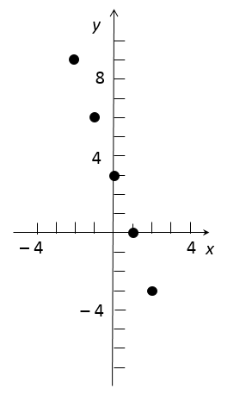
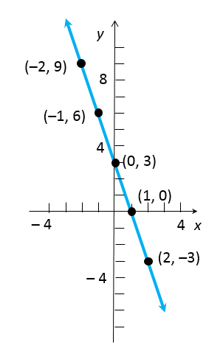
Example 2: Graphing an Equation by Plotting Points (2 of 2)
By plotting these points and then connecting them, we obtain the graph (a line) of the equation y = –3x + 3, as shown below.
y = –3x + 3

Slide 9
Example 3: Graphing an Equation by Plotting Points (1 of 2)
Graph the equation:
The table provides several points on the
graph of
x |  | (x, y)
–2 |  | (–2, 2)
–1
0 |  | (0, 0)
1
2 |  | (2, 2)

Slide 10
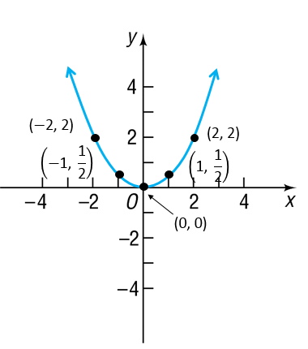
Example 3: Graphing an Equation by Plotting Points (2 of 2)
Plotting these points and connecting them with a smooth curve gives the graph (a parabola) shown in the figure.

Slide 11
Intercepts
The points, if any, at which a graph crosses or touches the coordinate axes are called the intercepts of the graph.
The x-coordinate of a point at which the graph crosses or touches the x-axis is an x-intercept, and the y-coordinate of a point at which the graph crosses or touches the y-axis is a y-intercept.

Slide 12
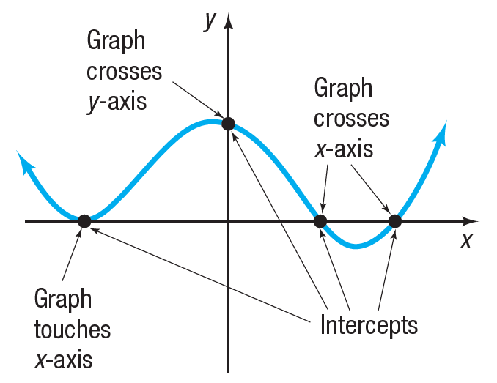
Intercepts
For a graph to be complete, all its intercepts must be displayed.

Slide 13
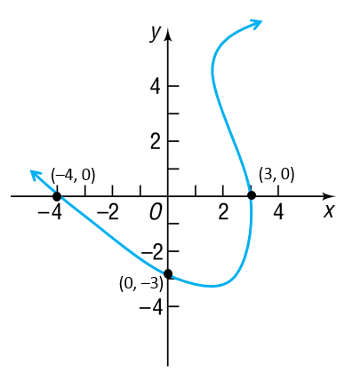
Example 4: Finding Intercepts from a Graph
Find the intercepts of the graph. What are its x-intercepts? What are its y-intercepts?
The intercepts on the
graph are the points
($−$4, 0), (3, 0), and (0, $−$3).
The x-intercepts are 3
and $−$4.
The y-intercept is $−$3.

Slide 14
Find Intercepts from an Equation

Slide 15
Example 5: Finding Intercepts from an Equation (1 of 3)
Find the x-intercept(s) and the y-intercept(s) of the graph of y = x² – 9. then graph y = x² – 9 by plotting points.
To find the x-intercept(s), let y = 0 and obtain the equation
x² – 9 = 0
The equation has two solutions, 3 and –3.
The x-intercepts are 3 and –3.
(x – 3)(x + 3) = 0
x – 3 = 0 or x + 3 = 0
x = 3 or x = –3

Slide 16
Example 5: Finding Intercepts from an Equation (2 of 3)
To find the y-intercept(s), let x = 0 in the equation.
y = x² – 9
y = 0² – 9
y = –9
The y-intercept is –9.

Slide 17
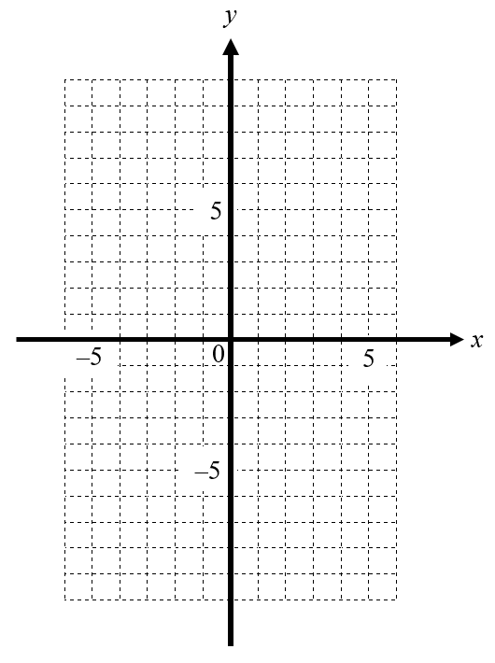
Example 5: Finding Intercepts from an Equation (3 of 3)
Since x² > 0 for all x, we deduce from the equation y = x² – 9 that y > –9 for all x. This information, the intercepts, and the points from the table below enable us to graph y = x² – 9.
x | y = x² – 9 | (x, y)
–4 | 7 | (–4, 7)
–2 | –5 | (–2, –5)
2 | –5 | (2, –5)
4 | 7 | (4, 7)

Slide 18
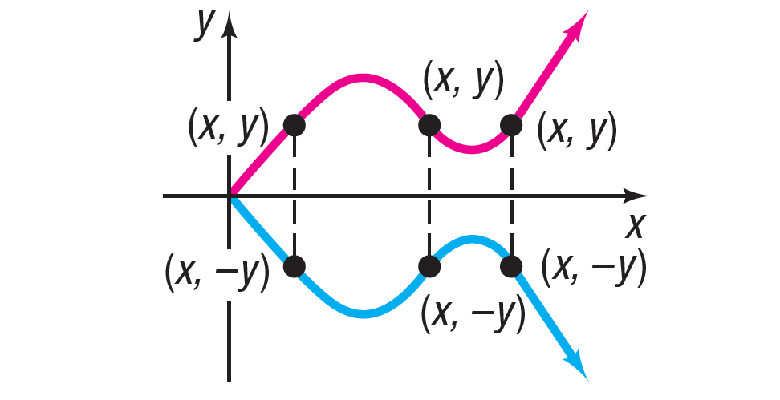
Test an Equation for Symmetry with Respect to the x-Axis
Symmetry with respect to the x-axis

Slide 19
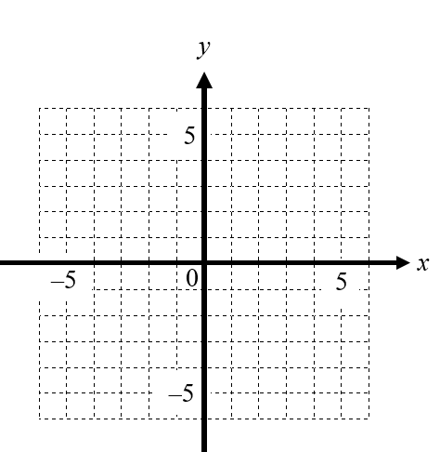
Example 6: Points Symmetric with Respect to the x-Axis
If a graph is symmetric with respect to the x-axis, and the point (5, 3) is on the graph, then the point (5, –3) is also on the graph.

Slide 20
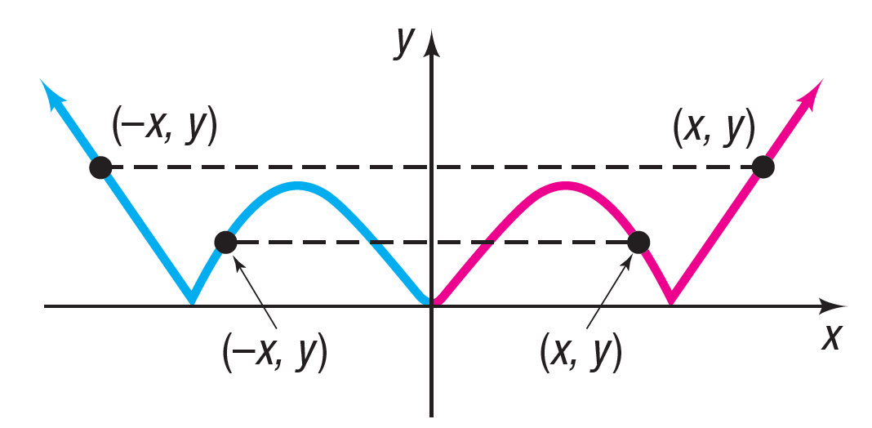
Test an Equation for Symmetry with Respect to the y-Axis
Symmetry with respect to the y-axis

Slide 21
Example 7: Points Symmetric with Respect to the y-Axis
If a graph is symmetric with respect to the y-axis, and the point (5, 3) is on the graph, then the point ($\text{–}$5, 3) is also on the graph.

Slide 22
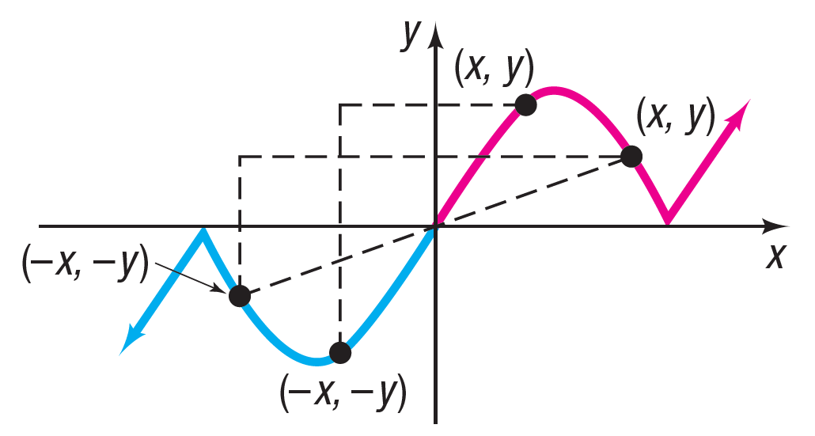
Test an Equation for Symmetry with Respect to the Origin
Symmetry with respect to the origin

Slide 23
Example 8: Points Symmetric with Respect to the Origin
If a graph is symmetric with respect to the origin, and the point (5, 3) is on the graph, then the point (–5, –3) is also on the graph.

Slide 24
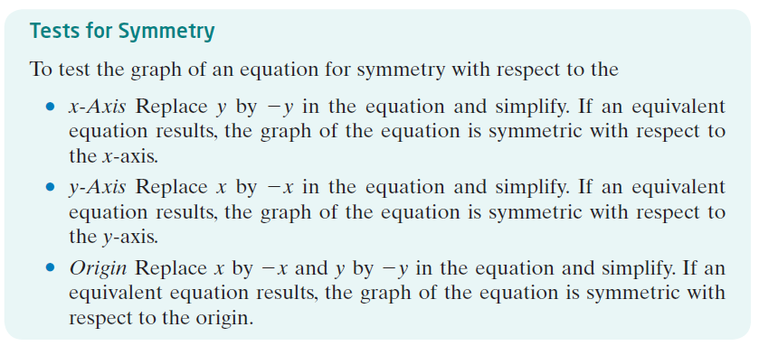
Test for Symmetry

Slide 25
Example 9: Testing an Equation for Symmetry (1 of 2)
Test 9x² + 16y² = 25 for symmetry.
x-Axis: To test for symmetry with respect to the x-axis, replace y by –y.
Since 9x² + 16(–y)² = 25 is equivalent to 9x² + 16y² = 25, the graph of the equation is symmetric with respect to the x-axis.

Slide 26
Example 9: Testing an Equation for Symmetry (2 of 2)
y-Axis: To test for symmetry with respect to the y-axis, replace x by –x.
Since 9(–x)² + 16y² = 25 is equivalent to 9x² + 16y² = 25, the graph of the equation is symmetric with respect to the y-axis.
Origin: To test for symmetry with respect to the origin, replace x by –x and y by –y.
Since 9(–x)² + 16(–y)² = 25 is equivalent to 9x² + 16y² = 25, the graph of the equation is symmetric with respect to the origin.

Slide 27
Example 10: Testing an Equation for Symmetry (1 of 3)
Test for symmetry.
x-Axis: To test for symmetry with respect to the x-axis, replace y by –y. Since is not equivalent to the graph of the equation is not symmetric with respect to the x-axis.

Slide 28
Example 10: Testing an Equation for Symmetry (2 of 3)
y-Axis: To test for symmetry with respect to the y-axis, replace x by –x. Since
is equivalent to , the graph of the equation is symmetric with respect to the y-axis.

Slide 29
Example 10: Testing an Equation for Symmetry (3 of 3)
Origin: To test for symmetry with respect to the origin, replace x by –x and y by –y.
Since the result is not equivalent to the original equation, the graph is not symmetric with respect to the origin.

Slide 30
Example 11: Graphing the Equation y = x³ by Finding Intercepts and Checking for Symmetry (1 of 4)
Graph the equation y = x³ by plotting points. Find any intercepts and check for symmetry first.
First, find the intercepts. When x = 0, then y = 0; and when y = 0, then x = 0. The origin (0, 0) is the only intercept. Now test for symmetry.

Slide 31
Example 11: Graphing the Equation y = x³ by Finding Intercepts and Checking for Symmetry (2 of 4)
x-Axis: Replace y by –y. Since –y = x³ is not equivalent to y = x³, the graph of the equation is not symmetric with respect to the x-axis.
y-Axis: Replace x by –x. Since y = (–x)³ is not equivalent to y = x³, the graph of the equation is not symmetric with respect to the y-axis.
Origin: Replace x by –x and y by –y. Since –y = (–x)³ is equivalent to y = x³, the graph of the equation is symmetric with respect to the origin.

Slide 32
Example 11: Graphing the Equation y = x³ by Finding Intercepts and Checking for Symmetry (3 of 4)
To graph y = x³, use the equation to obtain several points on the graph.
Because of the symmetry, we only need to locate points on the graph for which x ≥ 0.
x | y = x³ | (x, y)
0 | 0 | (0, 0)
1 | 1 | (1, 1)
2 | 8 | (2, 8)
3 | 27 | (3, 27)

Slide 33
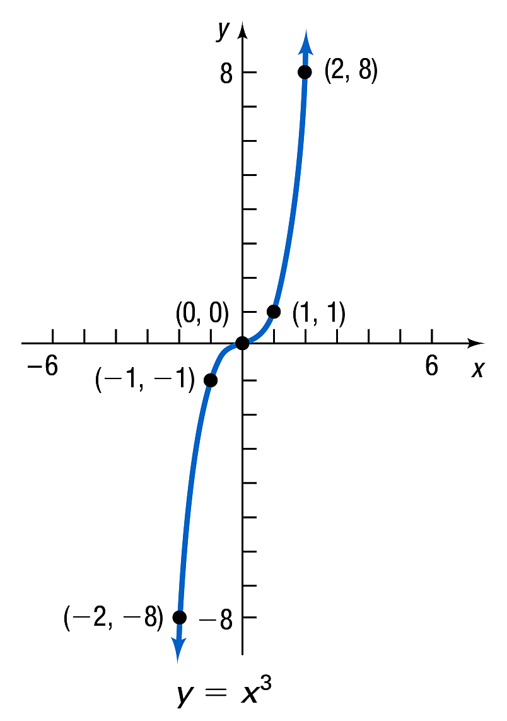
Example 11: Graphing the Equation y = x³ by Finding Intercepts and Checking for Symmetry (4 of 4)
Since (1, 1) is on the graph, and the graph is symmetric with respect to the origin, the point (–1, –1) is also on the graph.

Slide 34
Example 12: Graphing the Equation x = y² (1 of 3)
Graph the equation x = y². Find any intercepts and check for symmetry first.
Graph x = y², y ≥ 0.
The lone intercept is (0, 0). The graph is symmetric with respect to the x-axis since x = ($−$y)² is equivalent to x = y². The graph is not symmetric with respect to the y-axis or the origin.

Slide 35
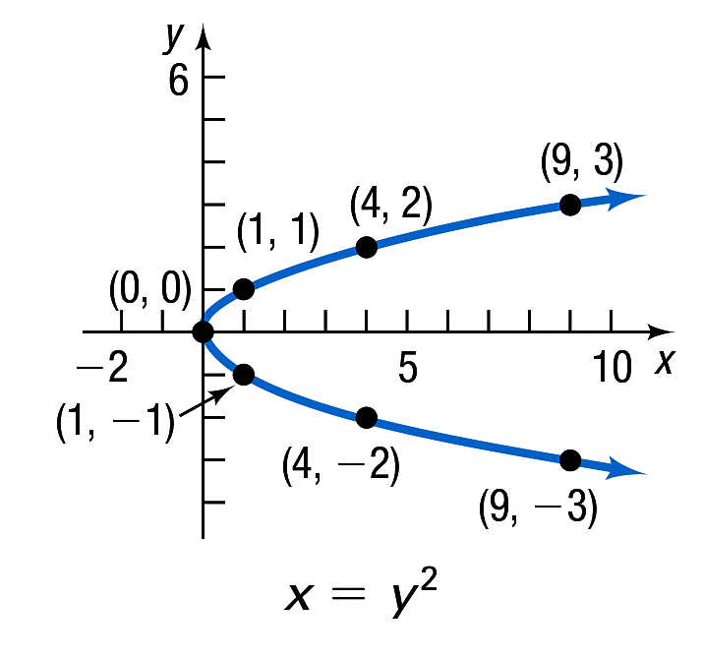
Example 12: Graphing the Equation x = y² (2 of 3)
Because of the symmetry, start by finding points whose y-coordinates are non-negative. Then use the symmetry to find additional points on the graph. See the table. Plot these points and connect them with a smooth curve to obtain the figure.
y | x = y² | (x, y)
0 | 0 | (0, 0)
1 | 1 | (1, 1)
2 | 4 | (4, 2)
3 | 9 | (9, 3)

Slide 36
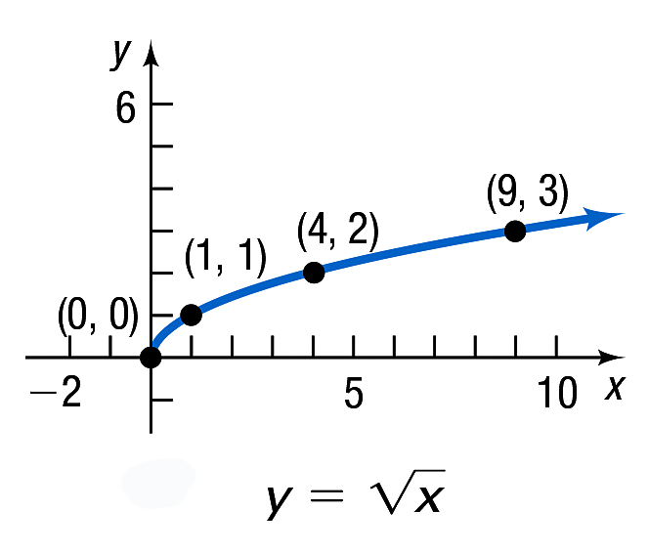
Example 12: Graphing the Equation x = y² (3 of 3)
If we restrict y so that y ≥ 0, the equation x = y², y ≥ 0, may be written equivalently as The portion of the graph of x = y² in quadrant I is therefore the graph of

Slide 37
Example 13: Graphing the Equation (1 of 3)
Graph the equation Find any intercepts
and check for symmetry.
Check for intercepts first. If we let x = 0, we obtain 0 in the denominator, which makes y undefined. We conclude that there is no y-intercept. If we let y = 0,
we get the equation which has no solution.
We conclude that there is no x-intercept.
The graph of does not cross or touch the
coordinate axes.

Slide 38
Example 13: Graphing the Equation (2 of 3)
Next check for symmetry:
x-Axis: Replacing y by –y yields which is not
equivalent to
y-Axis: Replacing x by –x yields which is
not equivalent to
Origin: Replacing x by –x and y by –y yields
which is equivalent to
The graph is symmetric with respect to the origin.

Slide 39
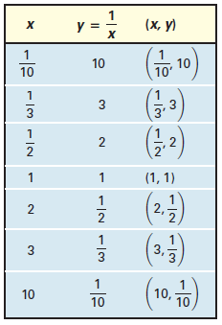
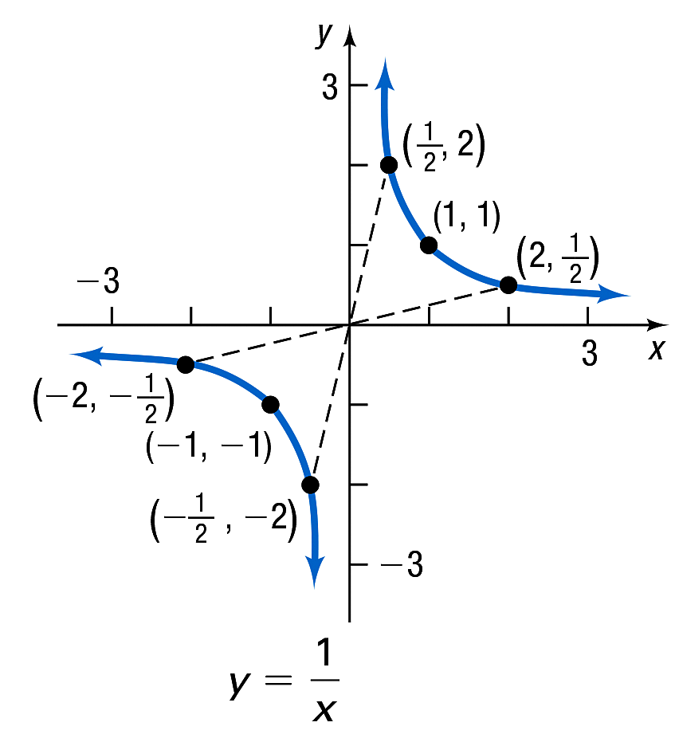
Example 13: Graphing the Equation (3 of 3)
Use the equation to form the table, and obtain some points on the graph. The figure illustrates some of these
points and the graph of

