Slide 1
Chapter R
Review

Slide 2
Section R.1
Real Numbers

Slide 3
Objectives
Work with Sets
Classify Numbers
Evaluate Numerical Expressions
Work with Properties of Real Numbers

Slide 4
Example 1: Using Set-builder Notation and the Roster Method
a) S = {x|x is an even digit less than 6}
= {0, 2, 4}
b) S = {x|x is a positive prime number}
= {1, 3, 5, 7, …}

Slide 5
Intersection and Union of Two Sets
DEFINITION Intersection and Union of Two Sets
If A and B are sets, the intersection of A with B, denoted A ∩ B, is the set consisting of elements that belong to both A and B. The union of A with B, denoted A ∪ B, is the set consisting of elements that belong to either A or B, or both.

Slide 6
Example 2: Finding the Intersection and Union of Sets(1 of 2)
Let A = {2, 4, 5, 9}, B = {3, 5, 7}, and C = {2, 4, 6, 8}. Find:
a)
b)
c)

Slide 7
Complement of a Set
DEFINITION Complement of a Set
If A is a set, the complement of A, denoted , is the set consisting of all the elements in the universal set that are not in A.

Slide 8
Example 3: Finding the Complement of a Set
If the universal set is U = {1, 2, 3, 4, 5, 6, 7, 8, 9} and if A = {2, 4, 6, 8},
then = {1, 3, 5, 7, 9}.

Slide 9
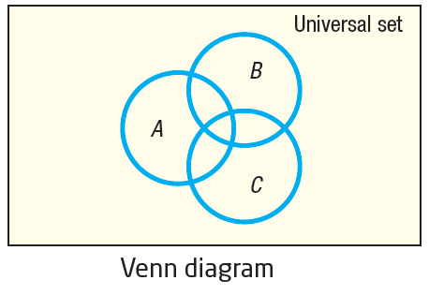
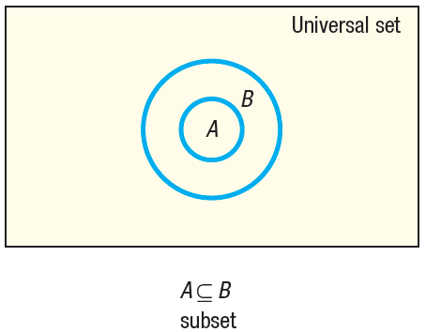
Venn Diagrams (1 of 3)
Venn diagrams represent sets as circles enclosed in a rectangle, which represents the universal set.
If we know that we might use the Venn diagram on the right to illustrate A is a subset of B.

Slide 10
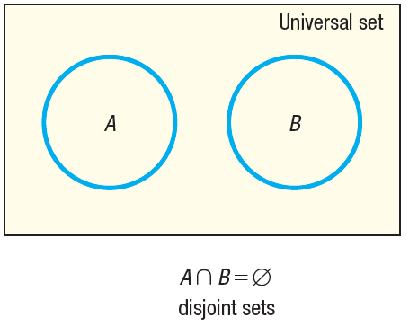
Venn Diagrams (2 of 3)
When A and B have no elements in common –that is, if the sets are said to be disjoint.

Slide 11
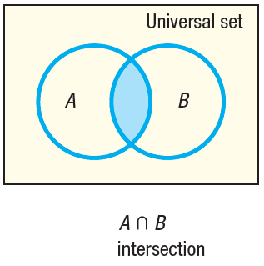
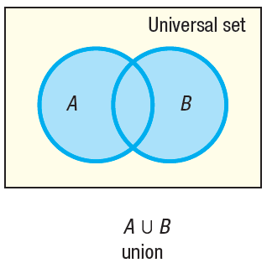
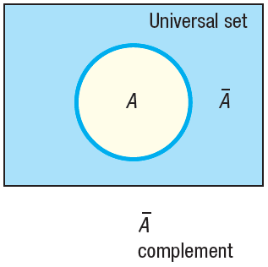
Venn Diagrams (3 of 3)
The following Venn diagrams illustrate intersection, union and complement, respectively.

Slide 12
Integers
DEFINITION Integers
The integers are the set of numbers
{…, –3, –2, –1, 0, 1, 2, 3, …}.

Slide 13
Rational Numbers
DEFINITION Rational Number
A rational number is a number that can be
expressed as a quotient of two integers. The integer a is called the numerator, and the integer b, which cannot be 0, is called the denominator. The rational numbers are the numbers in the set

Slide 14
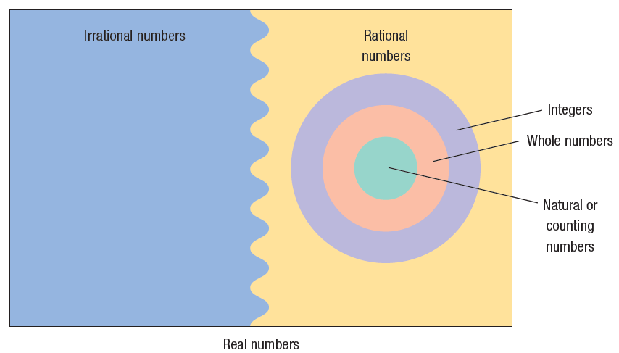
Real Numbers
DEFINITION Real Numbers
The set of real numbers is the union of the set of rational numbers with the set of irrational numbers.

Slide 15
Example 4: Classifying the Numbers in a Set (1 of 2)
List the numbers in the set
a) Natural numbers
2 is the only natural number.
b) Integers
–5 and 2 are integers.
c) Rational numbers
–5, 2, and are rational numbers.

Slide 16
Example 4: Classifying the Numbers in a Set (2 of 2)
d) Irrational numbers
are irrational numbers.
e) Real numbers
All the numbers listed are real numbers.

Slide 17
Approximations
Truncation: Drop all of the digits that follow the specified final digit in the decimal.
Rounding: Identify the specified final digit in the decimal. If the next digit is 5 or more, add 1 to the final digit; if the next digit is 4 or less, leave the final digit as it is. Then truncate following the final digit.

Slide 18
Example 5: Approximating a Decimal to Two Places (1 of 2)
Approximate 32.87625 to two decimal places by
Truncating
Rounding

Slide 19
Example 5: Approximating a Decimal to Two Places (2 of 2)
For 32.87625 the final digit is 7, since it is two decimal places from the decimal point.
To truncate, we remove all digits following the final digit 7. The truncation of 32.87625 to two decimal places is 32.87.
The digit following the final digit 7 is 6. Since 6 is 5 or more, we add 1 to the final digit 7 and truncate. The rounded form of 32.87625 to two decimal places is 32.88.

Slide 20
Example 6: Approximating a Decimal to Two and Four Places
Number
a) 2.71828
b) 0.35914
c) 32.29789
Rounded to Two Decimal Places
Rounded to Four Decimal Places
Truncated to Two Decimal Places
Truncated to Four Decimal Places
2.72
2.7183
2.71
2.7182
0.36
0.3591
0.35
0.3591
32.30
32.2979
32.29
32.2978

Slide 21
Operations
The symbols used in algebra for the operations of addition, subtraction, multiplication, and division are +, –, ⋅ , and /. The words used to describe the results of these operations are sum, difference, product, and quotient.

Slide 22
Example 7: Writing Statements Using Symbols
The sum of 3 and 9 equals 12.
In symbols, this statement is written as 3 + 9 = 12.
b) The product of 2 and 7 is 14.
In symbols, this statement is written as 2 ⋅ 7 = 14.

Slide 23
Evaluate Numerical Expressions
Consider the expression 2 + 3 ⋅ 6. It is not clear whether we should add 2 and 3 to get 5, and then multiply by 6 to get 30; or first multiply 3 and 6 to get 18, and then add 2 to get 20. To avoid this ambiguity, we have the following agreement.
We agree that whenever the two operations of addition and multiplication separate three numbers, the multiplication operation is always performed first, followed by the addition operation.

Slide 24
Example 8: Finding the Value of an Expression
Evaluate each expression.
a) 3 + 5 ⋅ 6
= 3 + 30 Multiply first.
= 33
b) 6 ⋅ 3 + 1
= 18 + 1 Multiply first.
= 19
c) 3 + 3 ⋅ 3
= 3 + 9 Multiply first.
= 12

Slide 25
Example 9: Finding the Value of an Expression
a) (3 + 5) ⋅ 6
= 8 ⋅ 6 Parentheses first.
= 48
b) (5 + 4) ⋅ (7 – 2)
= 9 ⋅ 5 Parentheses first.
= 45

Slide 26
Rules for the Order of Operations
1. Begin with the innermost parentheses and work outward. Remember that in dividing two expressions, we treat the numerator and denominator as if they were enclosed in parentheses.
2. Perform multiplications and divisions, working from left to right.
3. Perform additions and subtractions, working from left to right.

Slide 27
Example 10: Finding the Value of an Expression (1 of 2)
Evaluate each expression.
a) 7 ⋅ 3 + 4
= 21 + 4 Multiply first.
= 25
b) 6 ⋅ (3 + 4) + 2
= 6 ⋅ 7 + 2 Parentheses first.
= 42 + 2 Multiply before adding.
= 44

Slide 28
Example 10: Finding the Value of an Expression (2 of 2)
c)
d) 3 + [5 + 2 ⋅ (9 + 7)]
= 3 + [5 + 2 ⋅ (16)]
= 3 + [5 + 32]
= 3 + [37]
= 40

Slide 29
Work with Properties of Real Numbers
The reflexive property states that a number equals itself; that is, a = a.
The symmetric property states that if a = b, then b = a.
The transitive property states that if a = b and b = c, then a = c.
The principle of substitution states that if a = b, then we may substitute b for a in any expression containing a.

Slide 30
Example 11: Commutative Properties
a) 2 + 4 = 6
4 + 2 = 6
2 + 4 = 4 + 2
b) 3 ⋅ 6 = 18
6 ⋅ 3 = 18
3 ⋅ 6 = 6 ⋅ 3

Slide 31
Commutative Properties
Commutative Properties
a + b = b + a
a ⋅ b = b ⋅ a

Slide 32
Example 12: Associative Properties
a) 3 + (4 + 5) = 3 + 9 = 12
(3 + 4) + 5 = 7 + 5 = 12
3 + (4 + 5) = (3 + 4) + 5
b) 3 ⋅ (4 ⋅ 5) = 3 ⋅ 20 = 60
(3 ⋅ 4) ⋅ 5 = 12 ⋅ 5 = 60
3 ⋅ (4 ⋅ 5) = (3 ⋅ 4) ⋅ 5

Slide 33
Properties
Associative Properties
a + (b + c) = (a + b) + c = a + b + c
a ⋅ (b ⋅ c) = (a ⋅ b) ⋅ c = a ⋅ b ⋅ c
Distributive Properties
a ⋅ (b + c) = a ⋅ b + a ⋅ c
(a + b) ⋅ c = a ⋅ c + b ⋅ c

Slide 34
Example 13: Distributive Property (1 of 2)
a) 3 ⋅ (x + 1)
= 3 ⋅ x + 3 ⋅ 1 Use to remove parentheses.
= 3x + 3
b) 2x + 7x
= (2 + 7)x Use to combine two expressions.
= 9x

Slide 35
Example 13: Distributive Property (2 of 2)
c) (x + 4)(x + 5)
= x(x + 5) + 4(x + 5)
= (x² + 5x) + (4x + 20)
= x² + (5x + 4x) + 20
= x² + 9x + 20

Slide 36
Example 14: Identity Properties
a) 3 + 0 = 0 + 3 = 3
b) 4 ⋅ 1 = 1 ⋅ 4 = 4

Slide 37
Properties
Identity Properties
0 + a = a + 0 = a
a ⋅ 1 = 1 ⋅ a = a
Additive Inverse Property
a + (–a) = –a + a = 0

Slide 38
Example 15: Finding an Additive Inverse
a) The additive inverse of 5 is –5, because 5 + (–5) = 0.
b) The additive inverse of –7 is 7, because –7 + 7 = 0.

Slide 39
Multiplicative Inverse Property
Multiplicative Inverse Property

Slide 40
Example 16: Finding a Reciprocal
The reciprocal of 4 is because
The reciprocal of –8 is because
The reciprocal of is because

Slide 41
Difference and Quotient
DEFINITION Difference
The difference a – b, also read “a less b” or “a minus b,” is defined as
a – b = a + (–b)
DEFINITION Quotient
If b is a nonzero real number, the quotient
also read as “a divided by b” or “the ratio of a to b,” is defined as

Slide 42
Example 17: Working with Differences and Quotients
a) 7 – 4
= 7 + (–4)
= 3
b) 3 – 8
= 3 + (–8)
= –5
c)

Slide 43
Properties
Multiplication by Zero
a ⋅ 0 = 0
Division Properties

Slide 44
Rules of Signs
Rules of Signs
a(–b) = –ab (–a)b = –(ab) (–a)(–b) = ab
–(–a) = a

Slide 45
Example 18: Applying the Rules of Signs (1 of 2)
a) 3(–4)
= –(3 ⋅ 4)
= –12
b) (–4)(–6)
= 4 ⋅ 6
= 24

Slide 46
Example 18: Applying the Rules of Signs (2 of 2)
c)
d)
e)

Slide 47
Cancellation Properties
Cancellation Properties
ac = bc implies a = b if c ≠ 0
if b ≠ 0, c ≠ 0

Slide 48
Example 19: Using the Cancellation Properties
a) If 3x = 9, then
3x = 9
3x = 3 ⋅ 3 Factor 9.
x = 3 Cancel the 3’s.
b)
Cancel the 5’s.

Slide 49
Zero-Product Property
Zero-Product Property
If ac = 0, then a = 0, b = 0, or both.

Slide 50
Example 20: Using the Zero-Product Property
If 3x = 0, then either 3 = 0 or x = 0.
Since 3 ≠ 0, if follows that x = 0.

Slide 51
Arithmetic of Quotients
Arithmetic of Quotients

Slide 52
Example 21: Adding, Subtracting, Multiplying, and Dividing Quotients (1 of 2)
a)
b)

Slide 53
Example 21: Adding, Subtracting, Multiplying, and Dividing Quotients (2 of 2)
c)
d)

Slide 54
Example 22: Finding the Least Common Multiple of Two Numbers
Find the least common multiple of 10 and 15.
To find the LCM of 10 and 15, we look at multiples of 10 and 15.
10, 20, 30, 40, 50, 60, 70, 80, 90, 100, 110, 120, …
15, 30, 45, 60, 75, 90, 105, 120, …
The common multiples are in red.
The least common multiple is 30.

Slide 55
Example 23: Using the Least Common Multiple to Add Two Fractions (1 of 2)
Find:
We use the LCM of the denominators of the fractions and rewrite each fraction using the LCM as a common denominator.
The LCM of the denominators (10 and 15) is 30. Rewrite each fraction using 30 as the denominator.

Slide 56
Example 23: Using the Least Common Multiple to Add Two Fractions (2 of 2)

