Slide 1

P
2
Differentiation
Copyright © Cengage Learning. All rights reserved.

Slide 2

Basic Differentiation Rules and Rates of Change
2.2
Copyright © Cengage Learning. All rights reserved.

Slide 3
Objectives
Find the derivative of a function using the Constant Rule.
Find the derivative of a function using the Power Rule.
Find the derivative of a function using the Constant Multiple Rule.
Find the derivative of a function using the Sum and Difference Rules.

Slide 4
Objectives
Find the derivatives of the sine function and of the cosine function.
Use derivatives to find rates of change.

Slide 5
The Constant Rule

Slide 6
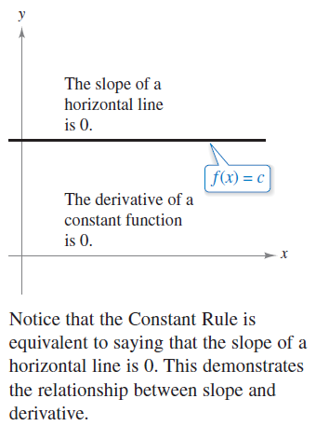
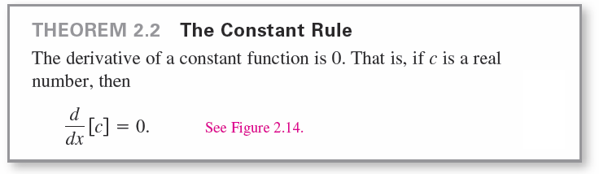
The Constant Rule
In this section, you will be introduced to several “differentiation rules” that allow you to find derivatives without the direct use of the limit definition.
Figure 2.14

Slide 7

Example 1 – Using the Constant Rule

Slide 8
The Power Rule

Slide 9
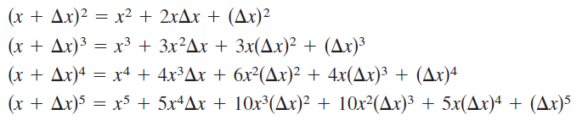
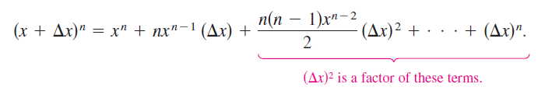
The Power Rule
Before proving the next rule, it is important to review the procedure for expanding a binomial.
The general binomial expansion for a positive integer n is
This binomial expansion is used in proving a special case of the Power Rule.

Slide 10
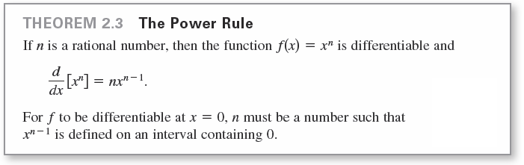
The Power Rule

Slide 11

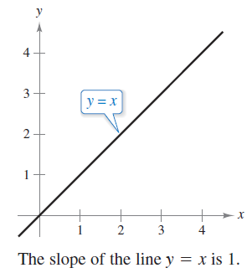
The Power Rule
When using the Power Rule, the case for which n = 1 is best thought of as a separate differentiation rule. That is,
This rule is consistent with the fact
that the slope of the line y = x is 1,
as shown in Figure 2.15.
Figure 2.15

Slide 12

Example 2 – Using the Power Rule

Slide 13
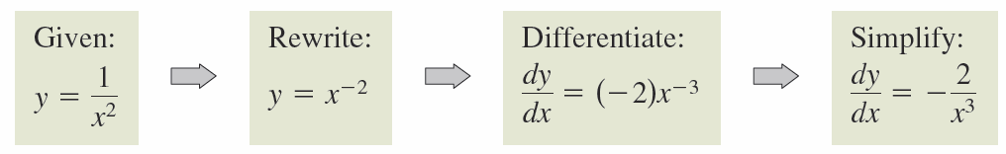
The Power Rule
In Example 2(c), note that before differentiating, 1/x² was rewritten as x^{–2}. Rewriting is the first step in many differentiation problems.

Slide 14
The Constant Multiple Rule

Slide 15
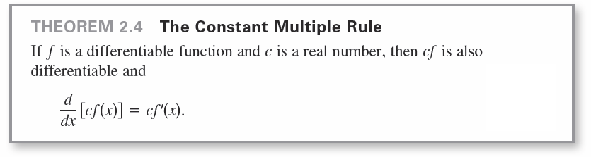
The Constant Multiple Rule

Slide 16



Example 5 – Using the Constant Multiple Rule

Slide 17

The Constant Multiple Rule
The Constant Multiple Rule and the Power Rule can be combined into one rule. The combination rule is

Slide 18
The Sum and Difference Rules

Slide 19
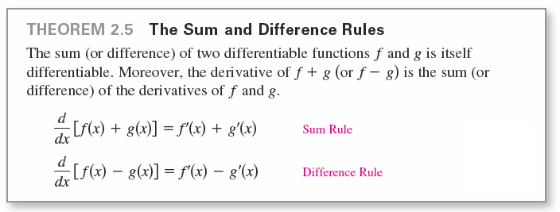
The Sum and Difference Rules

Slide 20


Example 7 – Using the Sum and Difference Rules

Slide 21
Derivatives of the Sine and Cosine Functions

Slide 22
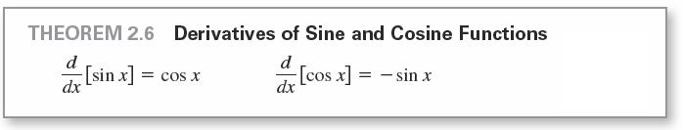
Derivatives of the Sine and Cosine Functions

Slide 23


Example 8 – Derivatives Involving Sines and Cosines

Slide 24
Rates of Change

Slide 25
Rates of Change
You have seen how the derivative is used to determine slope.
The derivative can also be used to determine the rate of change of one variable with respect to another.
Applications involving rates of change occur in a wide variety of fields.
A few examples are population growth rates, production rates, water flow rates, velocity, and acceleration.

Slide 26
Rates of Change
A common use for rate of change is to describe the motion of an object moving in a straight line.
In such problems, it is customary to use either a horizontal or a vertical line with a designated origin to represent the line of motion.
On such lines, movement to the right (or upward) is considered to be in the positive direction, and movement to the left (or downward) is considered to be in the negative direction.

Slide 27
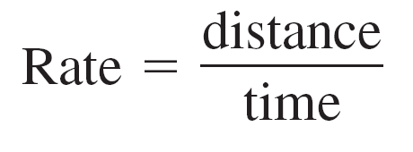

Rates of Change
The function s that gives the position (relative to the origin) of an object as a function of time t is called a position function.
If, over a period of time Δt, the object changes its position by the amount Δs = s(t + Δt) – s(t) then, by the familiar formula
the average velocity is

Slide 28
Example 9 – Finding Average Velocity of a Falling Object
A billiard ball is dropped from a height of 100 feet. The ball’s height s at time t is the position function
s = –16t² + 100 Position function
where s is measured in feet and t is measured in seconds. Find the average velocity over each of the following time intervals.
a. [1, 2] b. [1, 1.5] c. [1, 1.1]

Slide 29
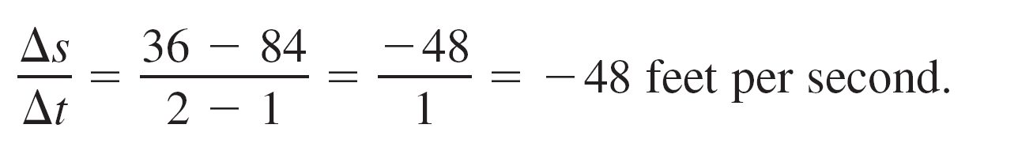
Example 9(a) – Solution
For the interval [1, 2], the object falls from a height of
s(1) = –16(1)² + 100 = 84 feet to a height of
s(2) = –16(2)² + 100 = 36 feet.
The average velocity is

Slide 30
Example 9(b) – Solution
cont’d
For the interval [1, 1.5], the object falls from a height of 84 feet to a height of
s(1.5) = –16(1.5)² + 100 = 64 feet.
The average velocity is

Slide 31
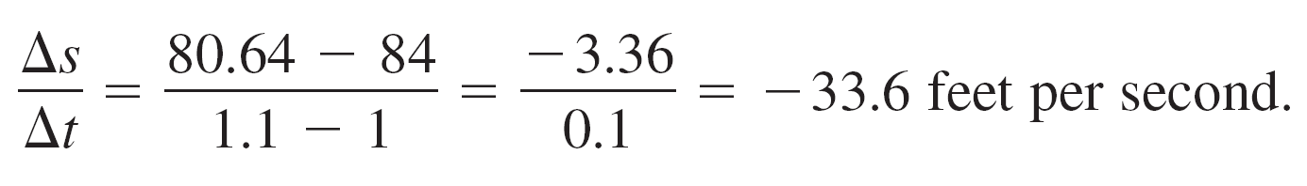
Example 9(c) – Solution
cont’d
For the interval [1, 1.1], the object falls from a height of 84 feet to a height of
s(1.1) = –16(1.1)² + 100 = 80.64 feet.
The average velocity is
Note that the average velocities are negative, indicating that the object is moving downward.

Slide 32
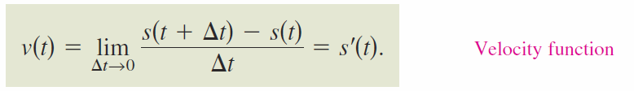
Rates of Change
In general, if s = s(t) is the position function for an object moving along a straight line, the velocity of the object at time t is
In other words, the velocity function is the derivative of the position function. Velocity can be negative, zero, or positive.
The speed of an object is the absolute value of its velocity. Speed cannot be negative.

Slide 33
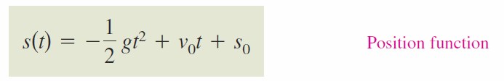
Rates of Change
The position of a free-falling object (neglecting air resistance) under the influence of gravity can be represented by the equation
where s₀ is the initial height of the object, v₀ is the initial velocity of the object, and g is the acceleration due to gravity.
On Earth, the value of g is approximately 32 feet per second per second or 9.8 meters per second per second.

Slide 34
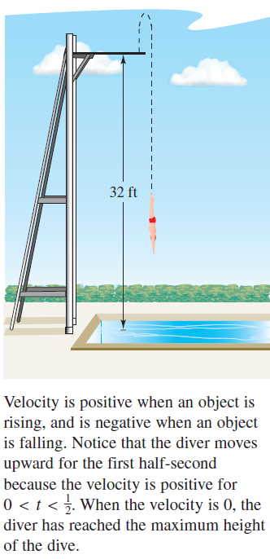
Example 10 – Using the Derivative to Find Velocity
At time t = 0 seconds, a diver jumps from a platform diving board that is 32 feet above the water (see Figure 2.21). The initial Velocity of the diver is 16 feet per second.
When does the diver hit the water?
What is the diver’s velocity at impact?
Figure 2.21

Slide 35

Example 10 – Solution
Begin by writing an equation to represent the position of the diver. Using the position function given above with g = 32 feet per second per second, v₀ = 16 feet per second, and s₀ = 32 feet, you can write

Slide 36
Example 10 – Solution
cont’d
To find the time t when the diver hits the water, let s = 0 and solve for t.
–16t² + 16t + 32 = 0 Set position function equal to 0.
–16(t + 1)(t – 2) = 0 Factor.
t = –1 or 2 Solve for t.
Because t ≥ 0, choose the positive value to conclude that
the diver hits the water at t = 2 seconds.

Slide 37
Example 10 – Solution
cont’d
The velocity at time t is given by the derivative
So, the velocity at time is t = 2 is
Notice that the unit for s ′(t) is the unit for s (feet) divided by the unit for t (seconds). In general, the unit for f ′(x) is the unit for f divided by the unit for x.

