Slide 1

3
Applications of Differentiation
P
Copyright © Cengage Learning. All rights reserved.

Slide 2

3.5
Limits at Infinity
Copyright © Cengage Learning. All rights reserved.

Slide 3
Objectives
Determine (finite) limits at infinity.
Determine the horizontal asymptotes, if any, of the graph of a function.
Determine infinite limits at infinity.

Slide 4
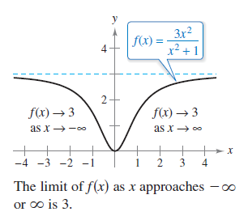
Limits at Infinity
This section discusses the “end behavior” of a function
on an infinite interval. Consider the graph of
as shown in Figure 3.32.
Figure 3.32

Slide 5
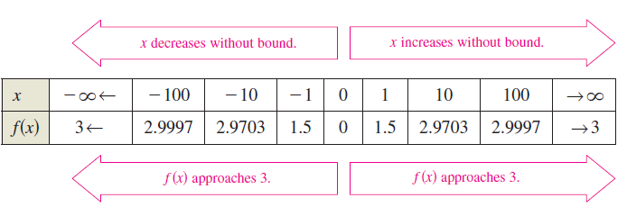
Limits at Infinity
Graphically, you can see that f(x) appears to approach 3 as x increases without bound or decreases without bound. You can come to the same conclusions numerically, as shown in the table.

Slide 6


Limits at Infinity
The table suggests that f(x) approaches 3 as x increases without bound . Similarly, f(x) approaches 3 as x decreases without bound .
These limits at infinity are denoted by
and

Slide 7
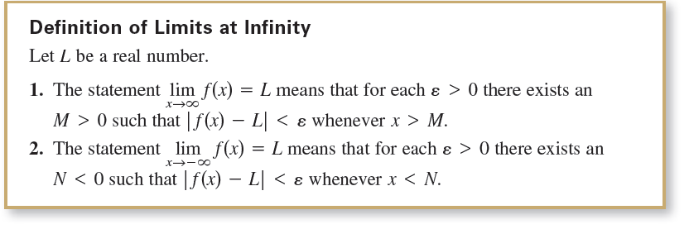
Limits at Infinity
To say that a statement is true as x increases without bound means that for some (large) real number M, the statement is true for all x in the interval {x: x > M}.
The next definition uses this concept.

Slide 8
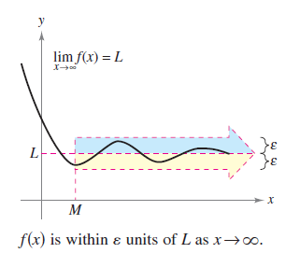
Limits at Infinity
The definition of a limit at infinity is shown in Figure 3.33. In this figure, note that for a given positive number ε , there exists a positive number M such that, for x > M, the graph of f will lie between the horizontal lines
y = L + ε and y = L – ε.
Figure 3.33

Slide 9
Horizontal Asymptotes

Slide 10
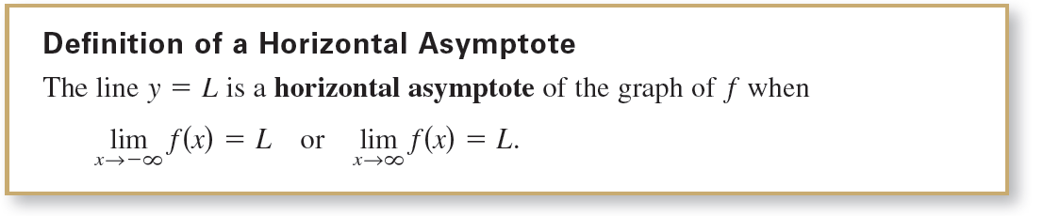
Horizontal Asymptotes
In Figure 3.33, the graph of f approaches the line y = L as x increases without bound. The line y = L is called a horizontal asymptote of the graph of f.
Note that from this definition, it follows that the graph of a function of x can have at most two horizontal asymptotes—one to the right and one to the left.

Slide 11


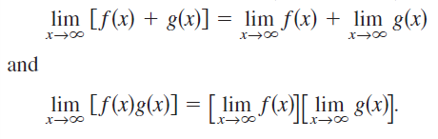
Horizontal Asymptotes
Limits at infinity have many of the same properties of limits discussed earlier. For example, if and both exist, then
Similar properties hold for limits at

Slide 12
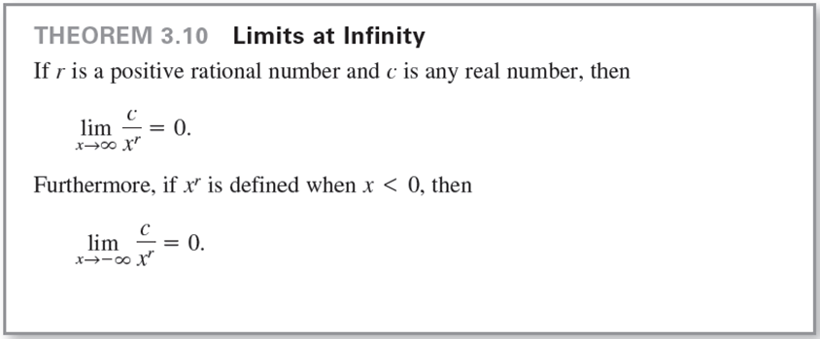
Horizontal Asymptotes
When evaluating limits at infinity, the next theorem is helpful.

Slide 13
Example 1 – Finding a Limit at Infinity
Find the limit:
Solution:
Using Theorem 3.10, you can write

Slide 14

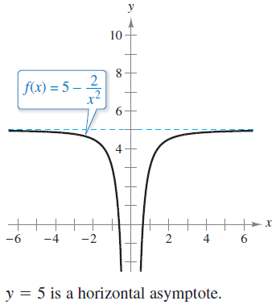
Example 1 – Solution
cont’d
So, the line y = 5 is a horizontal asymptote to the right. By finding the limit
you can see that y = 5 is also a
horizontal asymptote to the left.
The graph of the function
is shown in Figure 3.34.
Figure 3.34

Slide 15
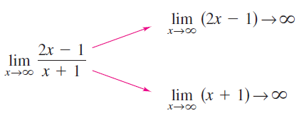
Example 2 – Finding a Limit at Infinity
Find the limit:
Solution:
Note that both the numerator and the denominator approach infinity as x approaches infinity.

Slide 16
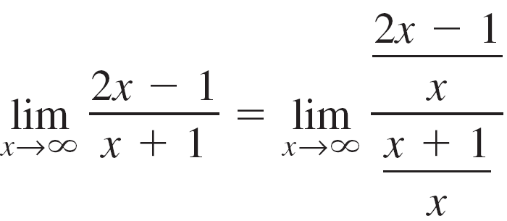
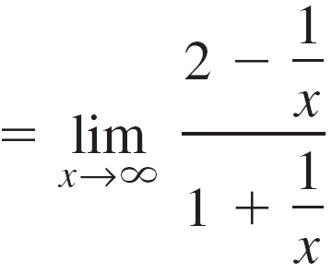
Example 2 – Solution
cont’d
This results in an indeterminate form. To resolve this
problem, you can divide both the numerator and the
denominator by x. After dividing, the limit may be evaluated
as shown.

Slide 17
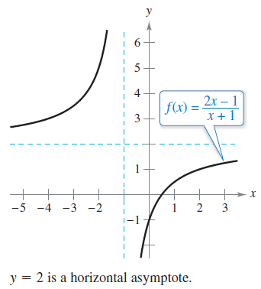

Example 2 – Solution
cont’d
So, the line y = 2 is a horizontal asymptote to the right.
By taking the limit as ,
you can see that y = 2 is also a horizontal asymptote to the left.
The graph of the function is shown in Figure 3.35.
Figure 3.35

Slide 18
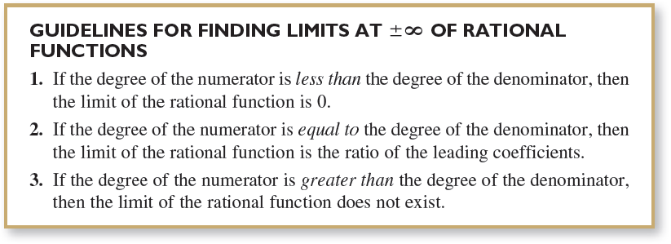
Horizontal Asymptotes

Slide 19
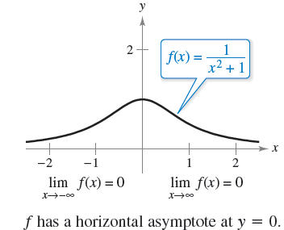

Horizontal Asymptotes
The guidelines for finding limits at infinity of rational functions seem reasonable when you consider that for large values of x, the highest-power term of the rational function is the most “influential” in determining the limit.
For instance,
is 0 because the denominator
overpowers the numerator
as x increases or decreases
without bound, as shown
in Figure 3.37.
Figure 3.37

Slide 20

Horizontal Asymptotes
The function shown in Figure 3.37 is a special case of a type of curve studied by the Italian mathematician Maria Gaetana Agnesi.
The general form of this function is
The curve has come to be known as the Witch of Agnesi.

Slide 21
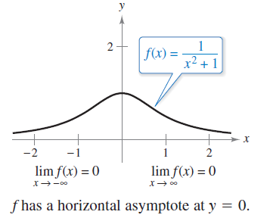

Horizontal Asymptotes
In Figure 3.37, you can see that
the function
approaches the same horizontal
asymptote to the right and to the
left.
This is always true of rational functions. Functions that are not rational, however, may approach different horizontal asymptotes to the right and to the left.
Figure 3.37

Slide 22
Example 4 – A Function with Two Horizontal Asymptotes
Find each limit.

Slide 23
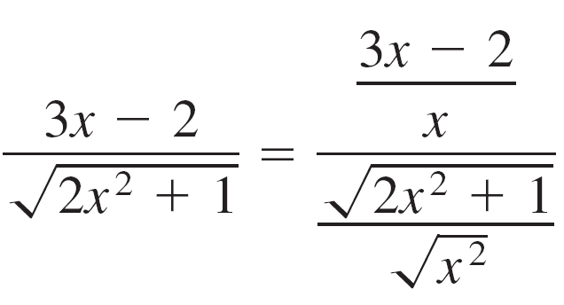
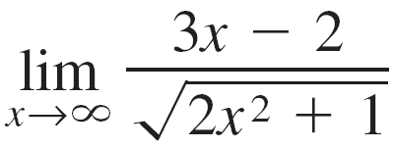
Example 4(a) – Solution
For x > 0, you can write
So, dividing both the numerator and the denominator by x produces
and you can take the limit as follows.

Slide 24

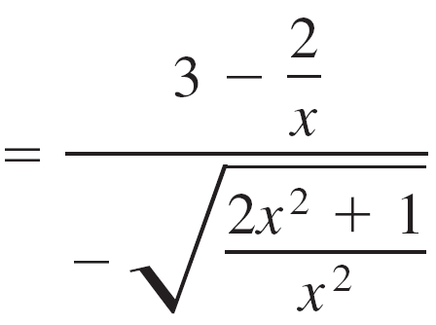
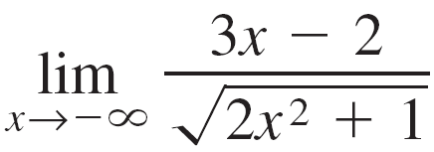
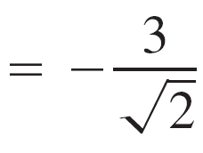
Example 4(b) – Solution
cont’d
For x < 0, you can write
So, dividing both the numerator and the denominator by x produces
and you can take the limit as follows.

Slide 25
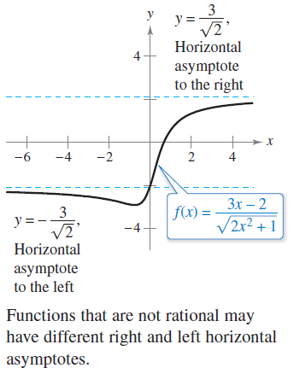
Example 4(b) – Solution
cont’d
The graph of is shown
in Figure 3.38.
Figure 3.38

Slide 26
Infinite Limits at Infinity

Slide 27
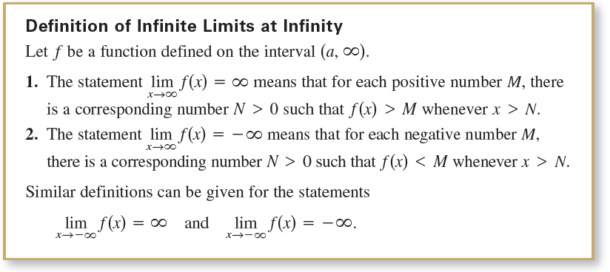
Infinite Limits at Infinity
Many functions do not approach a finite limit as x increases (or decreases) without bound. For instance, no polynomial function has a finite limit at infinity. The next definition is used to describe the behavior of polynomial and other functions at infinity.

Slide 28
Example 7 – Finding Infinite Limits at Infinity
Find each limit.
Solution:
a. As x increases without bound, x³ also increases without bound. So, you can write
b. As x decreases without bound, x³ also decreases without bound. So, you can write

Slide 29
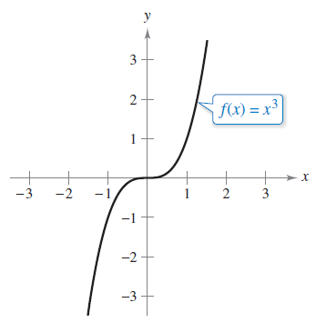
Example 7 – Solution
cont’d
The graph of f(x) = x³ in Figure 3.42 illustrates these two
results. These results agree with the Leading Coefficient Test for polynomial functions.
Figure 3.42

